Slide 1
3.3 Project Task 2: Executive Summary
Amit Saxena
4/19/24

Slide 2
Agenda
Introduction
Data Selection
Visualizations
Conclusion
Ethical Considerations

Slide 3


Introduction
Problem
Due to recent unfortunate airline crashes, the media has been promoting statistics stating air is no longer a safe way to travel. The news and media outlets have been bombarding the public with reports and figures about the trends of airline safety and that things are not looking good.
Objective
To debunk the media theory using airline and automobile travel data.
combat this negative publicity and help tell the airline's side of the story.

Slide 4
Data Selection
Data used in the visualizations in this presentation:
1- U.S. Air Carrier Safety Data- Airline Safety, GitHub
2- Air vs Road Travel Data- Fatality Analysis Reporting System (FARS), NHTSA
3- Transportation Accidents by Mode- Fatality Analysis Reporting System (FARS), NHTSA
4- U.S. Air Carrier Safety Data- Airline Safety, GitHub
5- No. of Passengers in Millions (2004-2021)- Statistics, Bureau of Aircraft Accident Archives; ASN Aviation Safety Database, Aviation Safety Network
6- Commercial Aircraft Accidents- https://www.transtats.bts.gov/freight.asp; https://www.transtats.bts.gov/rtm91_02.htm

Slide 5

Fatalities/ 100K Departures & Flight Hours
As apparent from this chart the fatalities per 100K departures and per 100K flight hours have continuously declined

Slide 6

Total Accidents by Mode of Transportation
The bar chart on the left shows the comparison of accidents by mode of transportation.
It clearly highlights the small no. of accidents in air travel compared to highway, railroad, transit and waterborne.
Note: The scale is logarithmic so that all bars are visible in the chart
The pie chart above shows the count of accidents by mode of transportation- surface, waterborne and air.
Note: The accidents by air travel is barely visible due to the small count compared to other modes of transports

Slide 7
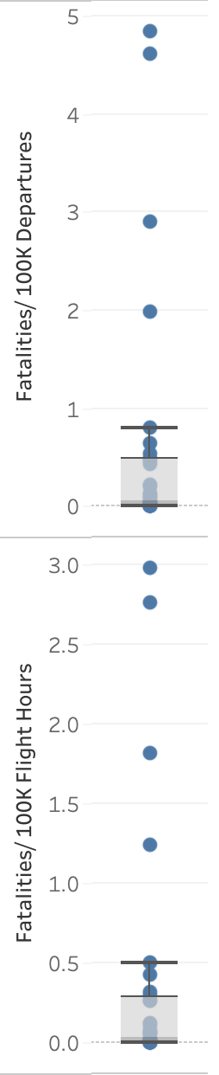


Fatalities/ 100K Departures & Flight Hours
The box plot charts shows the distribution of fatalities per 100K departures and per 100K flight hours.
It’s apparent from the median that the fatalities are very low in air travel and therefore it is a very safe mode of transportation.

Slide 8
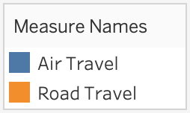
Comparison of Air and Road Travel
This comparison clearly highlights the extremely small no. of fatal accidents and fatalities in air travel when compared to fatal accidents and fatalities in road travel.
This proves the safety of air travel compared to road travel.

Slide 9

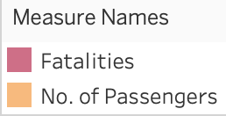
Fatalities vs Total No. of Passengers
This chart shows the comparison of fatalities in air travel compared to total no. of passengers over the years.
The trend line shows that the fatalities are trending towards zero in the last decade.
Note: The scale is logarithmic so that the fatalities are visible in the chart

Slide 10

Cargo Revenue vs Accident
This step chart shows the comparison of fatal accidents in cargo aircrafts compared to the revenue generated by air cargo.
The revenue has continuously increased over the years, whereas the fatal accidents are declining.
This comparison highlights overall safety of air transportation- whether passenger travel or cargo.
Note: The scale is logarithmic so that accidents are visible in the chart

Slide 11
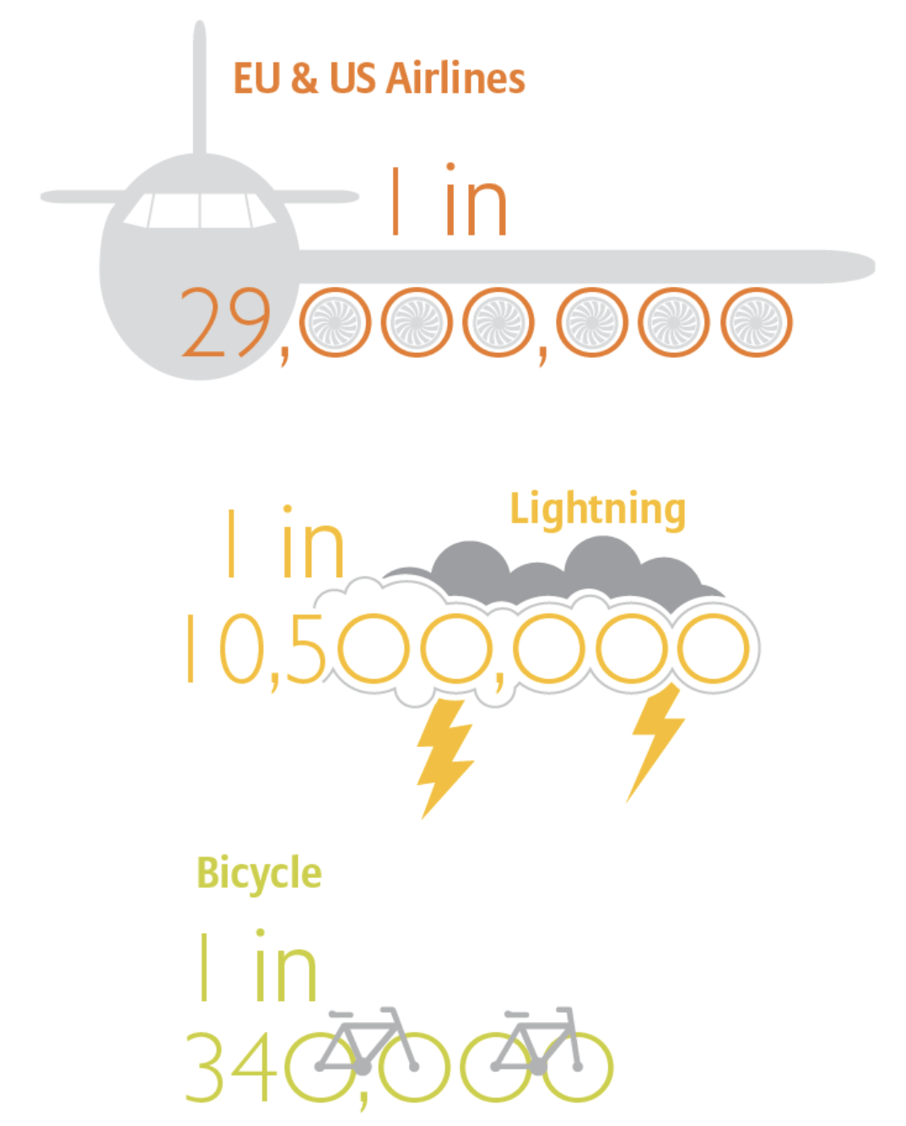
Conclusion
As per the data I used to research and create the visualizations in this presentation, it is very clear that air travel is a lot safer than other modes of transportations like road, rail or waterborne.
Apart from improved regulations, the improvements in engineering has also made air travel safer over the years. The engines are a lot more reliable today than they were in the past decades.
According to the FAA, commercial aviation fatalities in the US have decreased by 95% over the past 20 years, from 40 fatal accidents per million aircraft departures in 1959 to about 0.1 in 2022.
The International Civil Aviation Organization (ICAO) also reports that the aviation industry saw a 10% decrease in accidents in 2022 compared to 2020, along with a 65% drop in fatalities.
Engineering excellence
The improvement in airline safety is down to a combination of several factors, although the introduction of the jet engine in the 1950s stands out as a major development. Jet engines provide a level of safety and reliability unmatched by the earlier piston engines. Today, it is said that engine manufacturers have almost eliminated the chance of engine failure.
The introduction of electronics, most notable the introduction of digital instruments – known as the ‘glass cockpit’ in the 1970s – and the advent of fly-by-wire technology in the 1980s are also notable achievements, driving safety improvements. Improvements in sensors, navigation equipment and air traffic control technology, such as anti-collision control systems, have also played a role.
Link- https://commercial.allianz.com/news-and-insights/expert-risk-articles/how-aviation-safety-has-improved.html

Slide 12
Ethical Considerations
Road travel data is for U.S. only, while air travel data is global.
The safety regulations are country specific and may be more stringent in certain countries making air travel safer, causing negative perception of those countries.
The air traffic is higher in developed nations when compared to underdeveloped countries.
This data may unintentionally point towards the economic status of countries since some of the data sets contain airline specific information which could be related to the country that airline belongs to.

